Slide 1
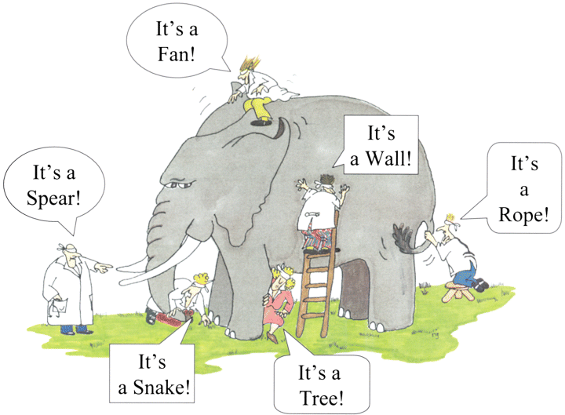


Cascadia Subduction Zone Creep Gina Schmalzle Rob McCaffrey and Ken Creager
G. Renee Guzlas, artist, source: http://www.nature.com/ki/journal/v62/n5/fig_tab/4493262f1.html
Notes:
Today I will be talking to you about the Cascadia Subduction zone that resides in the Pacific Northwest corner of the United States. My collaborators on this project are Rob McCaffrey at Portland State University and Ken Creager at the University of Washington.
A key question that geophysicists try to answer is “How much are tectonic plates “stuck” together? The answer to this question has major implications on seismic hazard since it is thought that the more plates are stuck, the larger the earthquake will be. Today I will talk about how much the North American plate is stuck (or not stuck) to the Juan de Fuca plate.
First, I wanted to share with you the story of the blind men and the elephant because this story pretty much sums up what I am presenting today, which is a culmination of data sets. In the story of the blind men and the elephant, there were a group of blind men that decided to figure out what an elephant was really like, having never seen one before. So, one of them approaches a tusk and examining it declared, hey, an elephant is like a spear! But then another one came up to its wriggling trunk and decided it was more like a snake. In fact, each blind man made their own conclusion of what an elephant was really like, but each of them only observed a small piece of the elephant. And so, these men all bickered about what an elephant really was like, and in reality they were all right because the elephant in fact has all of the properties the blind men said it had, but at the same time, they were all wrong.
In this study I bring together interdisciplinary data sets in order to get a fuller picture of what is going on with the tectonic plates in the Cascadia Subduction zone. To my knowledge, this is the first study that brings together these datasets in a comprehensive way to better understand subduction zone mechanics.

Slide 2
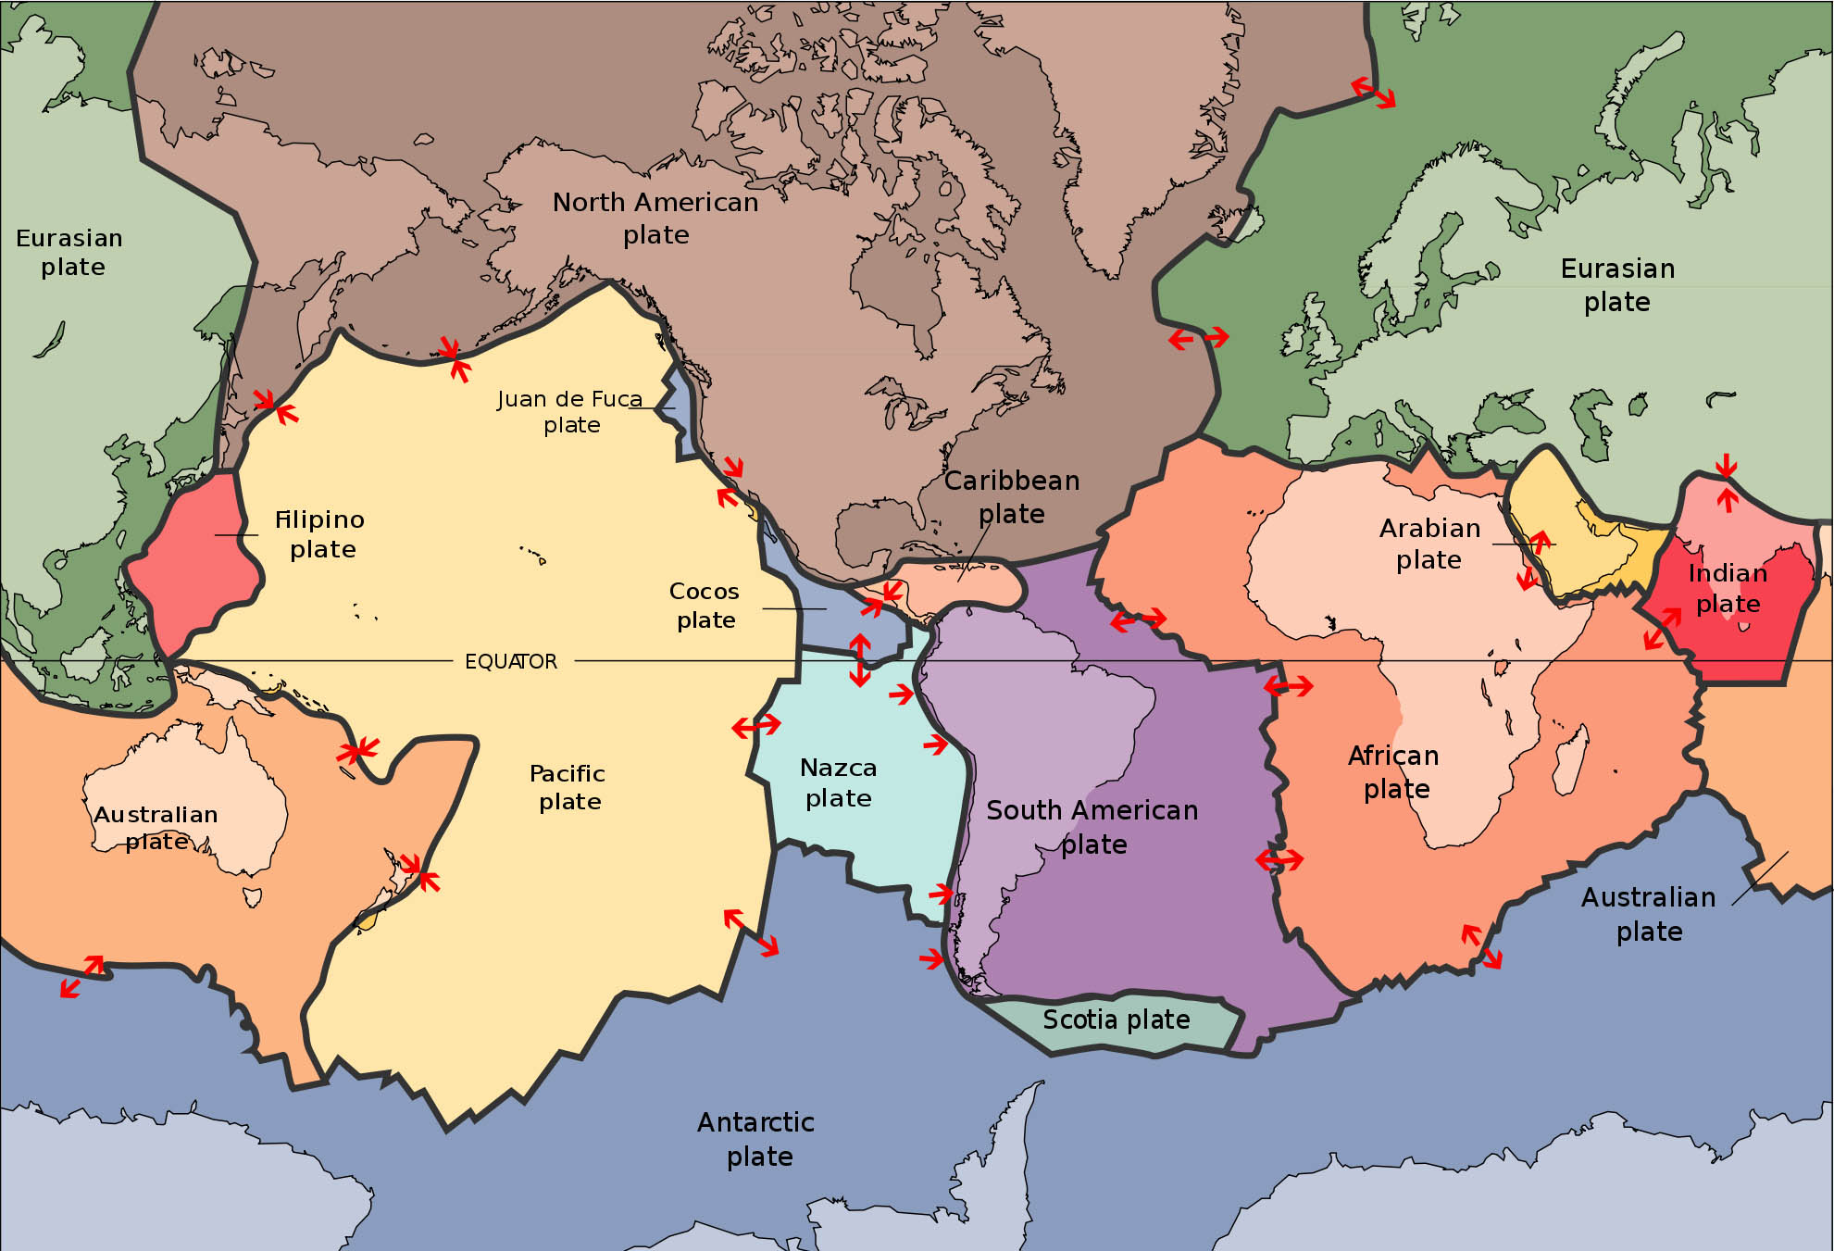
What the heck is a subduction zone???
Image from http://www.sanandreasfault.org/Tectonics.html
Notes:
OK, so I know this crowd is not geoscience oriented, so I am going to quickly review some key concepts for this talk. This is a map of the major tectonic plates that cover the earth. Each color represents a major plate. The plates rotate and translate with respect to each other all the time. The red arrows show how these plates are moving with respect to each other. They can move apart, which is what we see in Iceland and mid-oceanic ridges. The plates can also move laterally past each other, like the San Andreas fault, or, they can collide. When an oceanic plate collides with a continental plate, the oceanic plate “subducts” or moves underneath the continental plate. These areas are known as subduction zones and they can produce some of the largest earthquakes in the world. These earthquakes commonly reach magnitude 9 on the Richter scale and can produce tsunamis. The 2011 Japan earthquake and the 2004 Sumatra Earthquake were examples of megathrust earthquakes that occurred in subduction zones.
Today I will be talking about the Cascadia subduction zone which is found over here, in this corner of the world.

Slide 3
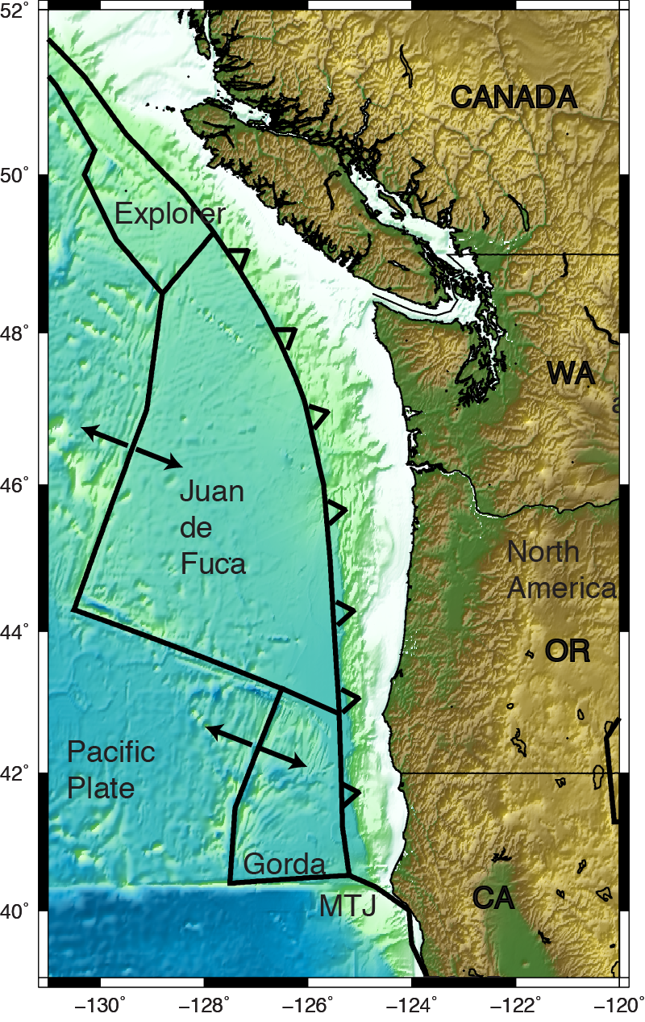
Cascadia Subduction Zone
Last Major Earthquake: ~9pm on January 26, 1700
We know precisely the time and date because of Tsunami records in Japan (Atwater et al., 2005)!
Rupture length: 1000 km
Plates slipped ~20 m!
Magnitude ~8.7-9.2
ETOPO 1 Bathymetry/Topography
Figure made with General Mapping Tools
Notes:
This is a zoomed in view of the Cascadia subduction zone. I’ve outlined the Explorer, Juan de Fuca and Gorda plates which are currently being subducted beneath the North America plate. The last major earthquake occurred in 1700, and we know precisely when because of records of a tsunami in Japan! Scientists have estimated that this quake was approximately 1000km in length and the plates slipped about 20m! Yikes! The estimated moment magnitude for this quake was approximately 9.

Slide 4
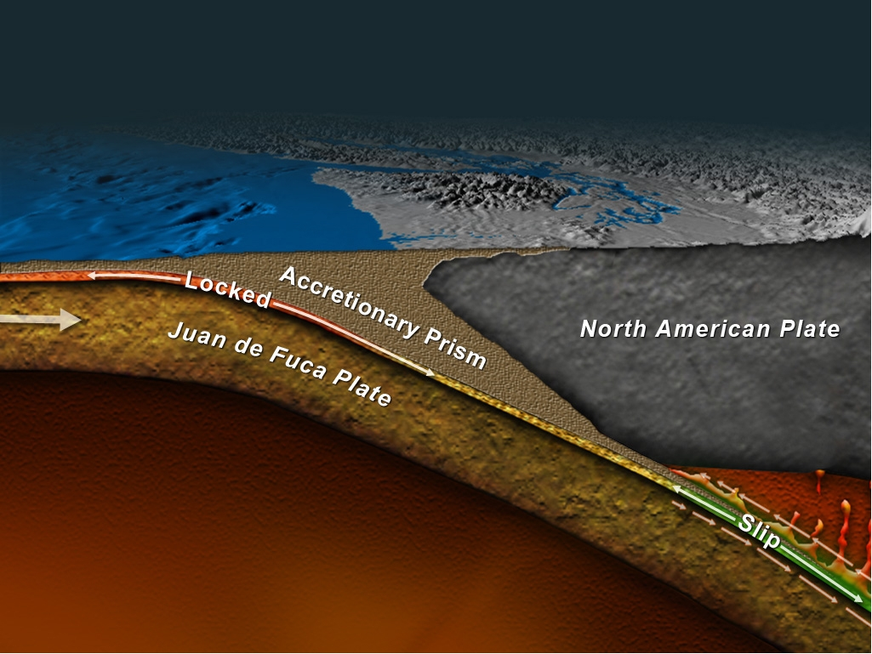


Cascadia Subduction Zone
Megathrust
Earthquakes!
“Locking” describes how much plates are stuck.
“Creep” describes how much plates slip between major earthquakes
Between major Earthquakes, Plate interface stuck and building stress
Figure from John Delaney, picture taken from a website I may regret being on…
Notes:
Let’s look a little deeper as to what is going on here. This is a cross section of the Cascadia Subduction Zone. Up here is the Olympic Peninsula, here is the Puget Sound and Seattle. And here is an artist’s rendition of the Juan de Fuca Oceanic plate subducting beneath the North America plate. The shallow end here is where the plates are thought to be stuck, or locked together. Further down-dip, the plates transition from fully locked, to fully creeping, where creeping is a measurement of how much the plates are slipping between large earthquakes. So, in the regions where the plates are stuck, lots of stress is building up, and is where the eventual megathrust earthquake is thought to occur.

Slide 5
Cascadia Subduction Zone
Where are the plates locked and by how much???
Important because this could tell you where and how large an impending earthquake will be.
Figure from John Delaney, picture taken from a website I may regret being on…
Notes:
Let’s look a little deeper as to what is going on here. This is a cross section of the Cascadia Subduction Zone. Up here is the Olympic Peninsula, here is the Puget Sound and Seattle. And here is an artist’s rendition of the Juan de Fuca Oceanic plate subducting beneath the North America plate. The shallow end here is where the plates are thought to be stuck, or locked together. Further down-dip, the plates transition from fully locked, to fully creeping, where creeping is a measurement of how much the plates are slipping between large earthquakes. So, in the regions where the plates are stuck, lots of stress is building up, and is where the eventual megathrust earthquake is thought to occur.

Slide 6
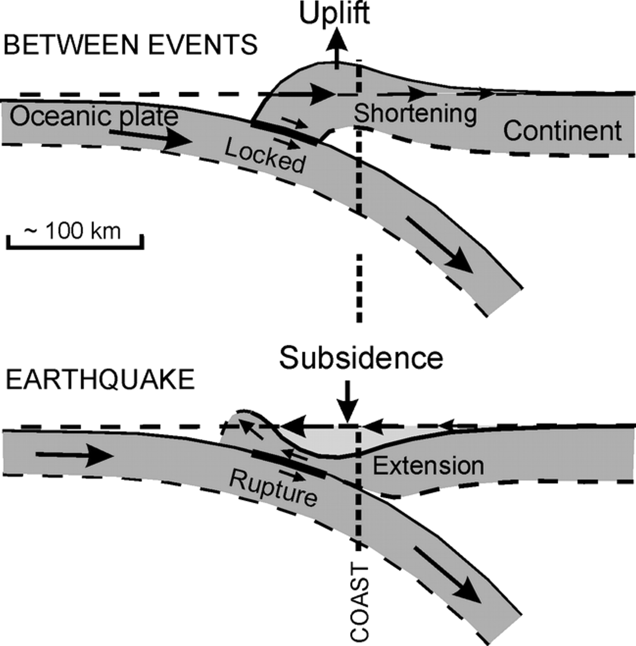
What happens when plates are stuck?
Japan experienced about a meter of subsidence at the coast. The tsunami was a whopping 10m high (33 ft)!
Image from Leonard et al. [2003]
Notes:
So, what happens when the plates are stuck? Well, the two plates are still moving toward each other. In order to accommodate that motion, the two plates that are stuck together must begin to bend. The continental crust begins to shorten and the ground near the coast begins to uplift.
When an earthquake happens, the two plates quickly slide past each other. The continental plate suddenly expands and subsides near the coast, and uplifts offshore. You can imagine the dire consequences of this – The plates uplifting shifts the entire water column up, generating a massive wave which will eventually propagate to shore, but the shore line has also gone down, allowing the tsunami wave, once it hits, to reach further inland and be more destructive. As an example, Japan experience about 3feet of subsidence from the earthquake that also generated a tsunami that reached 33 ft high. Yikes.

Slide 7

The Punch Line
Persistent inter-megathrust earthquake fault creep in central Cascadia
Creep!
Margin wide distributions of inter-megathrust uplift (and estimated locking) and subsidence from past earthquakes
ETOPO 1 Bathymetry/Topography
Notes:
The punch line of this study is that the amount of locking changes along the Cascadia Subduction zone. I will show you that the plates are more stuck off the coast of Washington, southern Oregon and California, and that the plates are less stuck in northern and central Oregon. I’ve come to this conclusion by trying to tie together observations from a variety of interdisciplinary studies, and like the blind men mentioned earlier, I attempt to piece together these datasets to make a simple, consistent story that explains all of them.

Slide 8
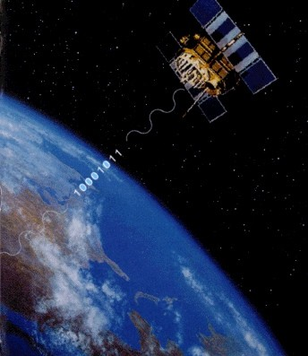
The Tusk: Global Positioning Systems (GPS)
GPS Satellite emit signals with known wavelengths (~19 and 24 cm).
Pseudorange: difference in time between satellite emission and detection on the ground and multiplying it by the speed of light.
At least 4 satellites needed for 3D positioning
Curently 32 healthy GPS satellites in orbit
GPS Satellite
Earth
Image from http://www.geosoft-gps.de/english/gps_infos/info_2_e.html
Notes:
Let’s dive into the first data set – High precision Global Positioning Systems. I am pretty certain that most of you have a GPS device in one form or another. The GPS that I use for this experiment are like the one that you have in your phone, but on steroids because they use a lot more of the information emitted by the satellite to calculate a position. A GPS satellite emits two wavelengths and some other information that help determine the distance of the satellite to a ground point (or say your phone). It is important that two different wavelengths are emitted because it helps in calculating some distortions in the passing through the ionosphere. In the most simplistic view of how distance is calculated, one can take the time difference between the emission of the signal and the detection at the ground point and multiply that time by the speed of light. That will give the satellite line of site distance, and to convert it to a 3 dimensional position, one would need the calculated range from at least 4 different satellites. There are currently 32 healthy GPS satellites in orbit, which means that any place on the earth, except maybe at the poles, can see at least 4 satellites at any given point in time.

Slide 9
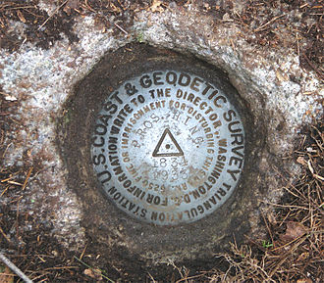
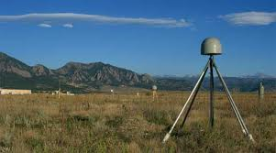
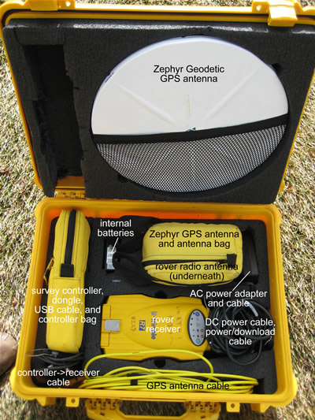
The Tusk: Global Positioning Systems (GPS)
http://en.wikipedia.org/wiki/Survey_marker
https://earthdata.nasa.gov/featured-stories/featured-research/looking-mud
http://facility.unavco.org/
Notes:
Back here on earth, we have permanently installed GPS monuments. These guys are usually installed in bedrock, if possible, or some other sturdy structure. You may have seen some of these monuments, here is an example of what one looks like. Down here is a Trimble 5700 GPS and a Zephyr Geodetic antenna – a little larger than your phone. The antenna is usually set up in this sort of configuration where a tripod is centered over the monument, and the antenna is on top of it. In this photo there is a protective cover that helps keep snow off the antenna which detects the signals from the satellite. The antenna is connected to the receiver, which collects that information.

Slide 10
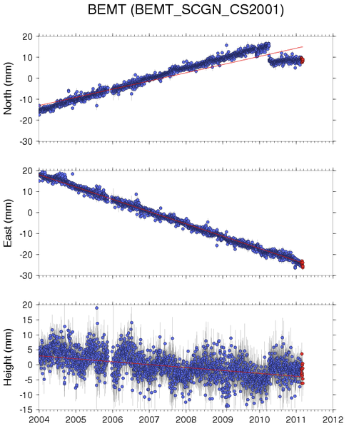
GPS
Blue dots – daily position estimates in North, East and Vertical directions for one site
Horizontal Velocity by eye:
θ
5 mm/yr
8.3 mm/yr
GPS Rate = sqrt(5^2+8.3^2) =
9.69 mm/yr
θ = atan (8.3/5) = 59 degrees
Notes:
Many of the continuously running GPS collect position information once per second, but uncertainties at these time intervals is pretty large. Commonly, these once per second position estimates are processed together to produce a daily position estimate, which greatly reduces its uncertainty to a few mm. On the right is an example of a GPS position time series for its three components – North, East and Vertical. The blue dots mark the daily position estimate, and the vertical black lines the uncertainties. Interestingly at this particular site there was a small earthquake nearby which caused this jump in the position time series. But, you can imagine that, ignoring the earthquake we can actually calculate the rate at which this monument is moving by taking the slope of the time series for each component.
Focusing on the horizontal velocities, we can estimate by eye that this site moved about 30 mm per 6 years, or 5 mm/yr. Similarly, the east component moved about 40 or 50 mm/yr over 6 years, about 8 mm/yr. By taking the square root of the squares of these velocities we can calculate a magnitude and we can also calculate the direction it was moving using these equations. So this gives you an idea of how a velocity is calculated. But, for you math geeks, I will briefly show you how I really did it --

Slide 11
For you math nerds…
Velocities are calculated by fitting the time series (least-squares) with the linear equation:
p = position
p_{o} = initial position
v = velocity
t = time
H = Heaviside function (step function) for earthquakes or equipment changes
A = amplitude of offset
U₁₋₄ = constants for seasonal variations
Notes:
I calculated the velocity by fitting the time series with this linear equation via the least squares method. This equation takes into consideration the initial start position, the velocity (which I am solving for), any sort of offset due to an earthquake or equipment changes, etc, and seasonal effects. Come speak to me afterwards if you have questions on this technique.

Slide 12
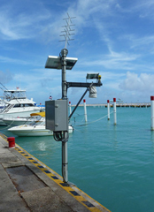
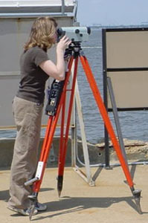
The Leg: Tide Gauge and Leveling Uplift Rates
www.oco.noaa.gov
Uplift rates from
Burgette et al [2009], observations from 1925-2006
Notes:
Another data set that I used was tide and leveling data sets. Remember earlier in the talk I mentioned that in between major earthquakes the region near the shoreline uplifts– which means it would look like sea level is lowering. This can be measured over time, and an estimate can be made on how much vertical movement happened over time.

Slide 13
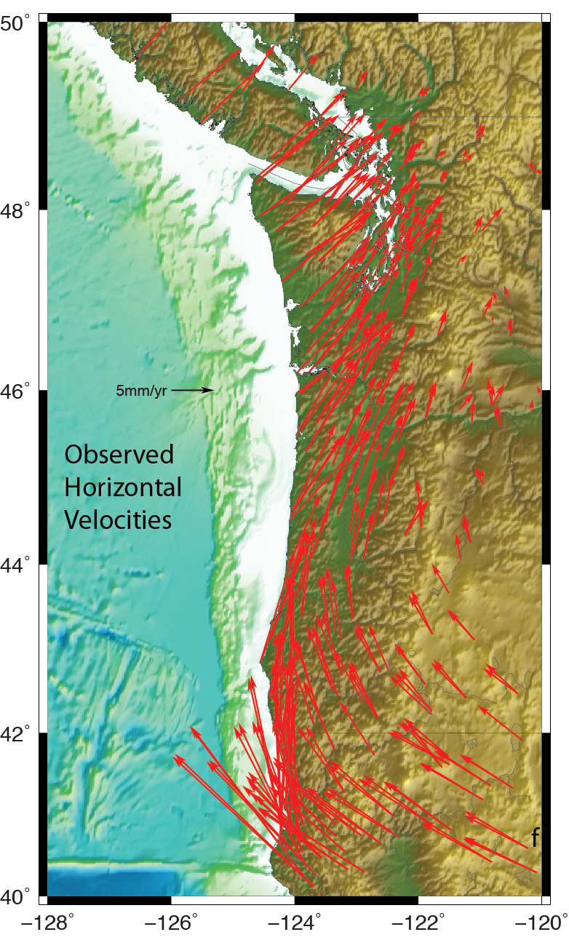
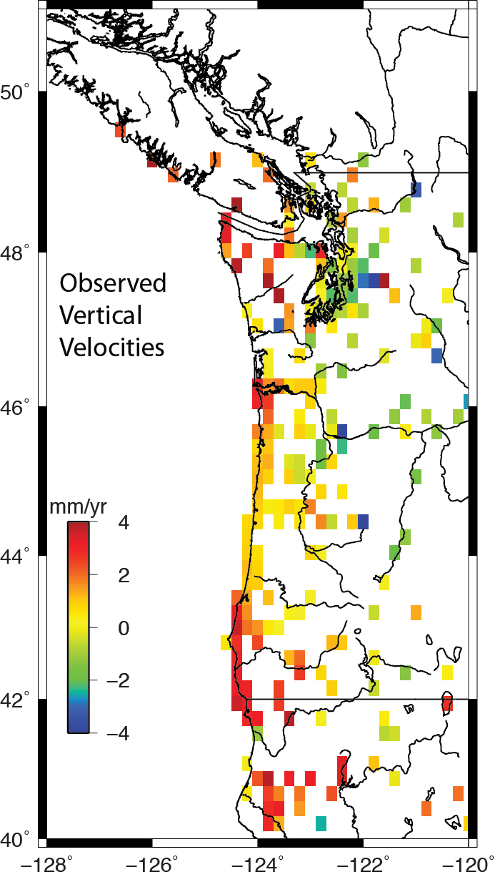
Inter-Megathrust Earthquake Velocities
PANGA and PBO GPS 3 component time series from 1997- 2013 used to derive velocities
Earthquakes and equipment changes removed
Tide and Leveling uplift rates from Burgette et. al. [2009]
Reduced coastal interseismic uplift from ~43-46°N
Notes:
OK, let’s look at these beautiful data!!! The map I am showing on the left has horizontal GPS velocities that are estimated from daily position time series from 1997 to 2013. These velocities are referenced to the stable North America interior, so you could imagine standing in Nebraska, looking longingly to the west coast, and watching the plates move like this. The arrows here originate at the GPS monument, are sized according to their magnitude, and point in the direction of their motion. Note the reference scale here is only 5 mm/yr. The monuments are screaming by down here in northern California and then rotate inland further north. Now let’s look at the vertical data set. For better illustration, I’ve color coded them so that warm colors represent more uplift. The key thing to notice about this data set is that there appears to be more uplift in the north and in the south, and a reduced amount of uplift in central and northern Oregon.

Slide 14
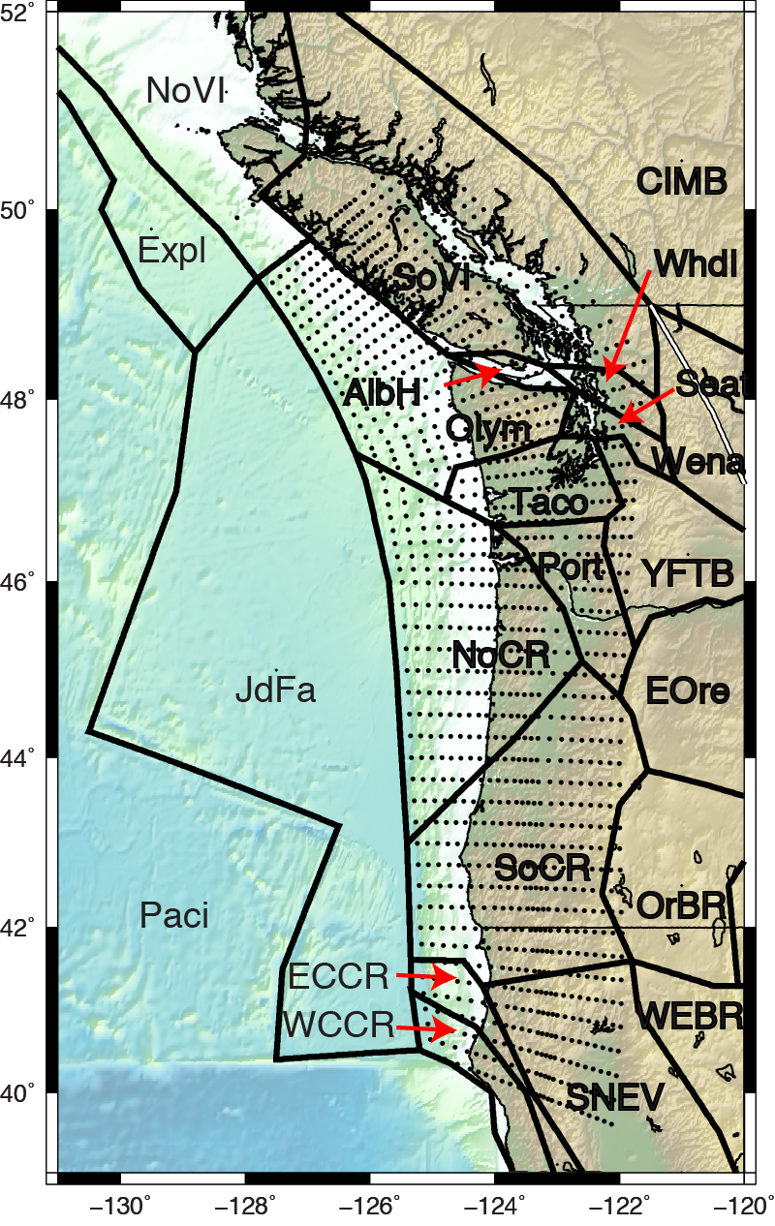
Mechanical Block Models
Mechanical models simulate how we think the earth works. Model contains parameters (fault rate, locking…).
TDEFNODE, block modeling software – Written in Fortran!
Block models divide the region into tectonic blocks
Fault defined by nodes; geometry based on McCrory et al. [2004]
Free Parameters: block rotations, deformation due to fault motion, fault locking
Velocity data applied to model, low misfit model parameters are solved
Problem: Locking non-unique – limited observations offshore
Notes:
Geophysicists try to figure out what in the world is going on by applying geophysical data to a mechanical model. What I mean is we think we know the basic concepts behind how the world works, so we build a mechanical model that will actually mimic what the earth is doing based on these concepts. One such model is called a block model. This type of model divides the corner of the earth you are working on into tectonic blocks that can move and rotate, and bend due to fault motions. We can use these models, along with the GPS data shown on the previous slide to estimate how much the plates are stuck together. The modeling program that I use is called TDEFNODE and it is a massive, wonderful beast of a code, written in Fortran! Yes, Fortran. This is an image of the Cascadia subduction zone with the block model geometry laid over top as these solid black lines. The dots here represent the interface between the subducting oceanic plate and the continental plate. It looks flat here, but really the fault interface is going down into the page.
OK -- We have our data, and we have our model. Only we have a big problem – The locking, which is what we are trying to solve is mostly offshore, where we don’t have any data to constrain the model! This means that the model is heavily reliant on the user assumptions.

Slide 15
Mechanical Block Models
Locking described in 2 ways:
Gaussian model –Gaussian locking distribution. Mean depth, width and amplitude are solved (e.g., McCaffrey et al. [2013])
Gamma Model – Fully locked near trench, transitioning by a function gamma to fully slipping down-dip (e.g., Wang et al. [2003]). Upper and lower depths of the transition zone and gamma are solved
Notes:
Hence, I will describe how much the plates are stuck in two ways – The first I call the Gaussian model, which assumes that the locking is distributed along strike in a Gaussian way, where it is minimal at the trench, crescendos to a maximum, and then tapers off down-dip. The second way assumes that the fault is completely locked from the trench to some distance before it begins to taper off again.

Slide 16
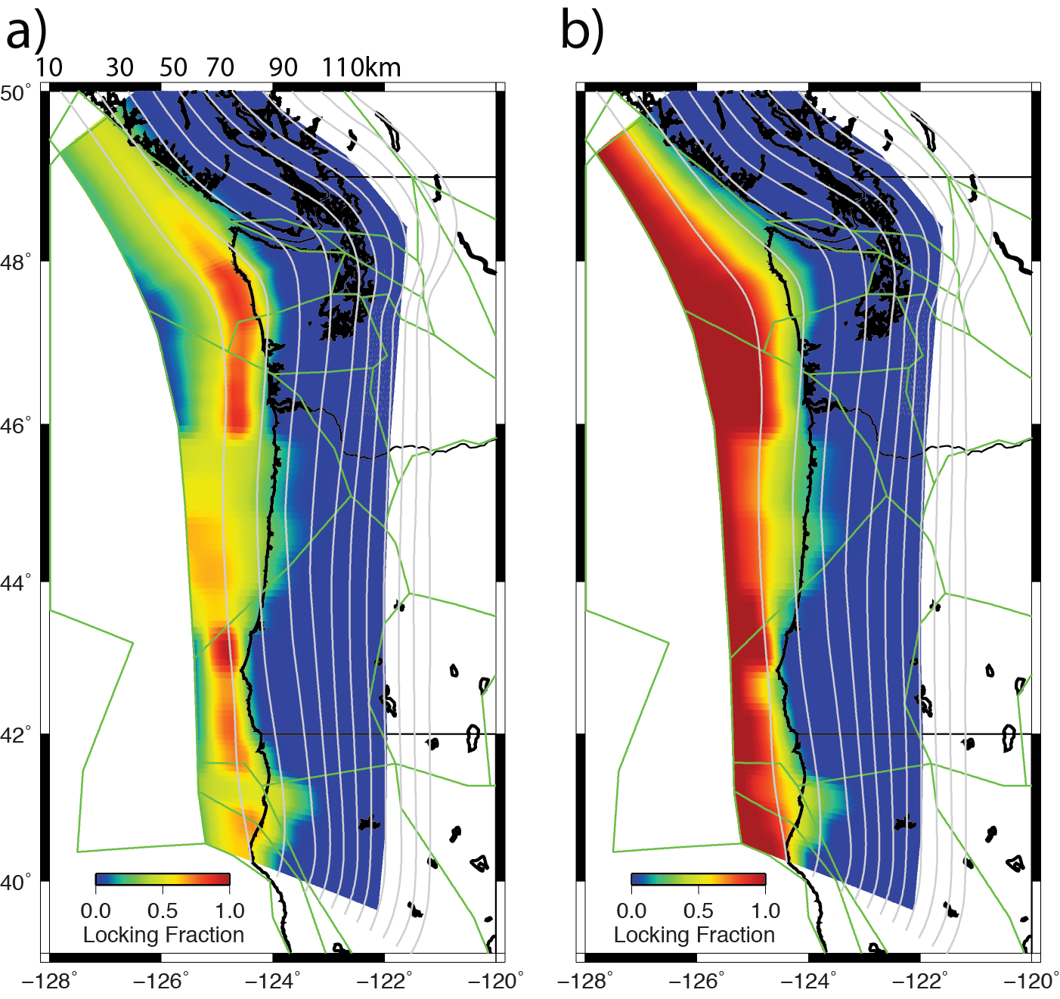
1. Locking Fraction
Gaussian Locking
Gamma Locking
Residuals nearly identical: reduced χ² = 1.6 for each
Locking distribution offshore dependent on model assumptions
Near the coast similar locking emerges
Wide transition zone between ~43-46°N
Notes:
And here are maps of my results! The grey lines are the coastlines, the green the modeled block geometery, and the colors are the locking fraction – where red indicates that the plate are stuck together more, and the cooler colors mean that the plates are less stuck. The residuals for each model are nearly identical in both cases, even though at first glance these models seem very different. But let’s take a closer look here. Both models show much more intense locking offshore in Washington and in northern California and southern Oregon. And the other strange feature is that there is a very wide transition zone between about 43 and 46 degrees north in central and northern Oregon. So, for these models, locking must be reduced in order to fit the data in this region.

Slide 17
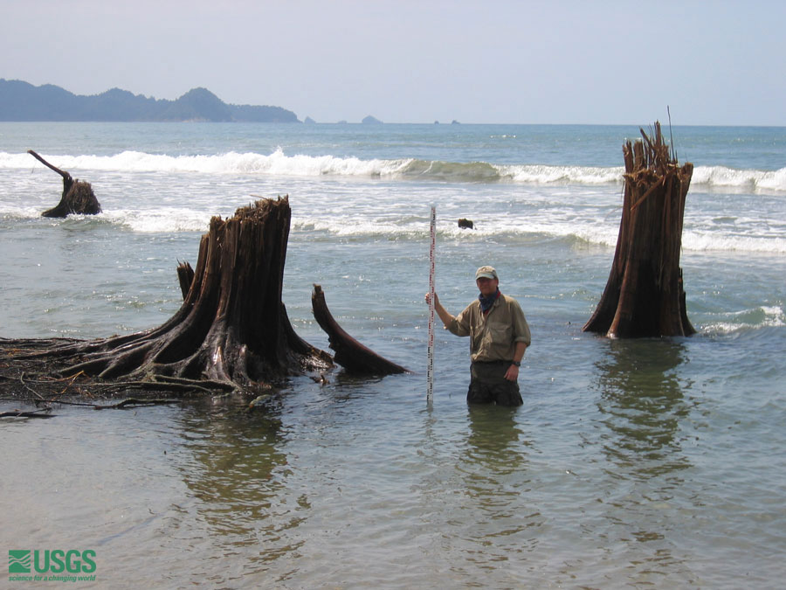
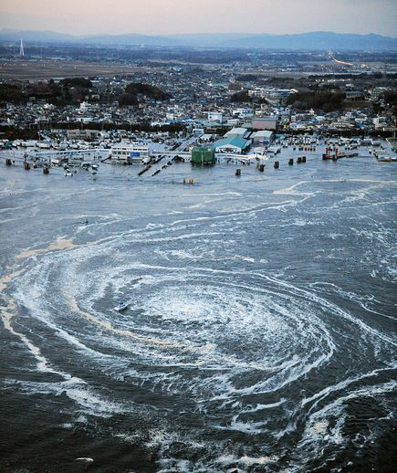
The Tail: Paleoseismic Data
Subsidence from 2004 Sumatra Earthquake
2011 Japan Tsunami
http://walrus.wr.usgs.gov/tsunami/sumatra05/subsidence.html
Photo from National Geographic
Notes:
For the past few slide, we have been talking about what happens in between major earthquakes. Let’s change gears a bit and think about what happens during an earthquake. Remember what happens during an earthquake, the continental crust uplifts offshore, potentially displacing the water column and producing a tsunami, and the near the coast the ground subsides, allowing the water to inundate the shore line much further than in between earthquakes. These photos shown here show the aftermath of the 2004 Sumatra earthquakes, which show these once thriving trees now submerged in salt water. The photo on the right shows a whirlpool that appeared during the 2011 Tsunami in Japan, but you can also see in this photo how far the water went inland, in both cases bringing in sediment and debris that would eventually settle out of the water column and form a geologic layer. Tsunami deposits can be seen in the geologic record, and is part of the paleoseismic record.

Slide 18
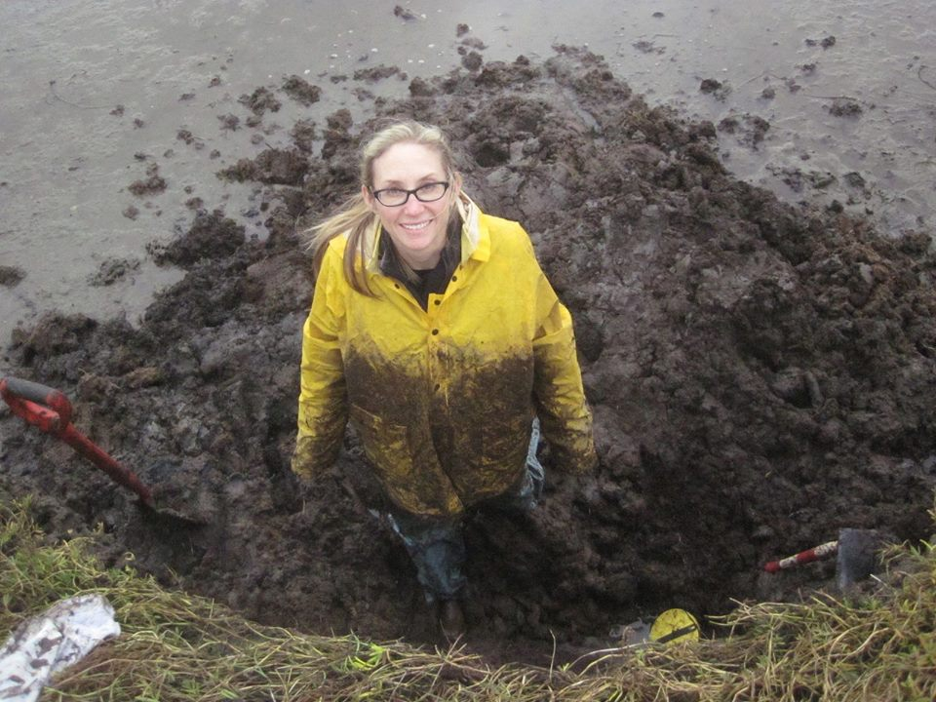
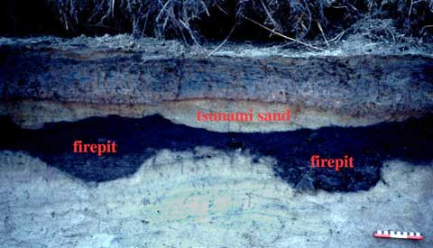
The Tail: Paleoseismic Data
Carrie Garrison-Laney
Notes:
There has been a lot of work done be real geologists, like Carrie here, who dig in the mud near coastlines, trying to find tsunami deposits. A tsunami deposit looks kind of like this, where it is a layer of sand surrounded by other geologic layers. It is really exciting to find old trees that perhaps died due to the salt water in these layers because it provides the scientist a method of dating the event. An estimate can also be made regarding how much the layer subsided using this technique.

Slide 19
Earthquake Subsidence from Paleoelevation Studies
Leonard et al., 2010 compile subsidence measurements from previous studies that includes events from the past 6500 years
Less subsidence from ~43.5-46N is a persistent feature of Cascadia great earthquakes
Central Cascadia has reduced
Inter-megathrust earthquake uplift
Subsidence due to earthquakes
1700 AD
750 AD
150 AD
650 BC
1150 BC
Notes:
Leonard et al [2010] compiled subsidence records from previous studies that include earthquakes from the past 6500 years in Cascadia. Are the paleoseismic subsidence records as a function of latitude, ranging from the north up here at 50 degrees in Canada to the South down in northern California. What they saw in their study was that for multiple past earthquakes, subsidence was reduced between 43 and 46 degrees north.
Hmmph...
So let’s recap what we have so far – in the same region, at about 43-46 degrees north, we have both reduced interearthquake uplift as well as reduced subsidence due to earthquakes!

Slide 20
My Elephant: Central Cascadia Creep
Inter-Seismic
Earthquake!
Locked
OC
CC
Mantle
Inter-Seismic
Earthquake!
Partial Creep
OC
CC
Mantle
Notes:
One way we can explain these observations is by fault creep in central Cascadia. In the locked scenario, the two plates are pushing together, creating uplift, which we see in Washington and California. This build up a lot of stress which is later released in a big earthquake.
In the case where the plates may be partially creeping the two plates are actually sliding past each other in between major earthquakes and stress doesn’t accumulate to the same extent – this means that we are less likely to see uplift in between earthquakes, and when an earthquake does happen somewhere along the margin, the slip is expected to be less since much of the slip was already accommodated between earthquakes.
So, now we have our theory, based on interdisciplinary research using GPS, tide and leveling guage and paleoseismic datasets.

Slide 21
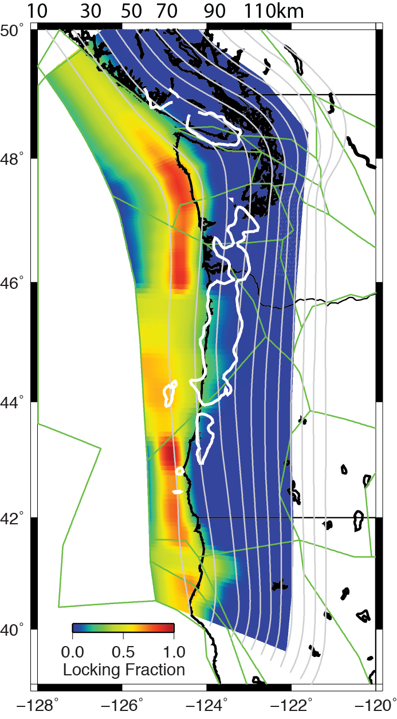
Why Creep in Central Cascadia?
Eocene (~50 Ma) age accreted basalt -- Siletz terrane influences locking [Burgette et al., 2009]
Rigid – few earthquakes and Impermeable (?)
Dense – Large gravity anomalies (white line, 10 mgal contour, Blakely et al., 2005)
Seismic surveys show it is thickest near coastal central OR; extends ~35km offshore in central OR [Trehu et al. 1994] and east of Olympic in WA (Parsons et al., 2005)
Notes:
OK, so if central Cascadia is indeed creeping, then why is it creeping??? Here are some more parts of the elephant to explore–
Geologic mapping, seismic and gravity data all indicate that there is this big, dense, blob of basalt, which is a volcanic rock, that makes up much of the continental crust in Cascadia . The figure to the right Is my locking distribution for one of my mechanical models, and this white line outlines the thickest and densest part of this mass using gravity data. The biggest chunk appears in central and northern Oregon, in the region we have this wide locking transition zone. Seismic surveys show that it is the thickest near coastal central Oregon and even extends about 35 km offshore. The mass thins to the north and south, and is absent in the Olympics up in this region.

Slide 22
Siletz Terrane – Creepy?
Geochemical reactions from high T and P release water
Impermeable terrane in overriding crust traps water and increases pore fluid pressure, encouraging creep
Siletz
Conceptual Model of
Reyners and Eberhart-Phillips, 2009
Trapped water from Basalt-Eclogite transition
Notes:
We suggest that the Siletz terrane may be impermeable, and traps fluid generated by the chemical transition of the crust due to higher temperatures and pressures. The trapped water increases the fluid pressure at the plate interface and encourages the creep.
Could it be that the Siletz terrane is our elephant, which is causing all of these other observations?

Slide 23
The Punch Line
Reduced inter-megathrust uplift rates (and inferred locking) and earthquake subsidence suggest persistent fault creep in central Oregon
We suggest the presence of an (impermeable?) 50Ma accreted basalt (Siletz) promotes creep
Regardless of why it is creeping, these results suggest central Cascadia will slip less during future great earthquakes, impacting the seismic hazard of the region.
Schmalzle, G.M., McCaffrey, R. Creager, K. Central Cascadia Subduction Zone Creep, Geochemistry, Geophysics, Geosystems, doi: 10.1002/2013GC005172, 2014
ginaschmalzle@gmail.com
geodesygina.com

Slide 26
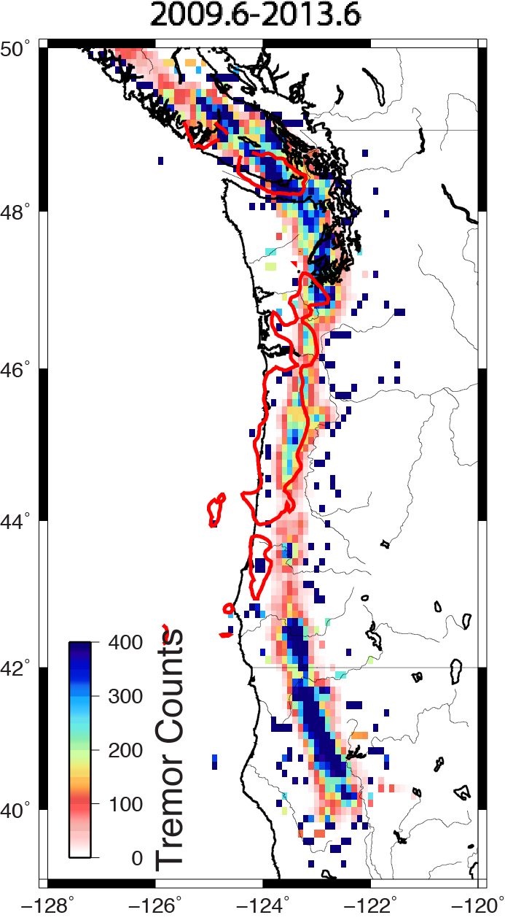
Does Creep influence ETS?
The Siletz may control ETS [Brudzinski and Allen, 2007]
Tremor Counts from Pacific NW Seismic Network catalog
Suppressed between 43-~47N – Coinciding with Siletz up-dip of tremor

Slide 27
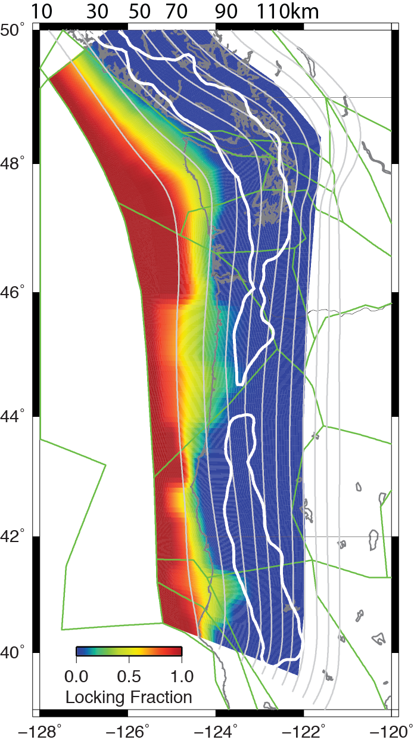
Does Creep influence ETS?
Wide locking transition zone (creep zone) may influence ETS recurrence and slow slip magnitude
Caveat –locking models are non-unique!

Slide 28
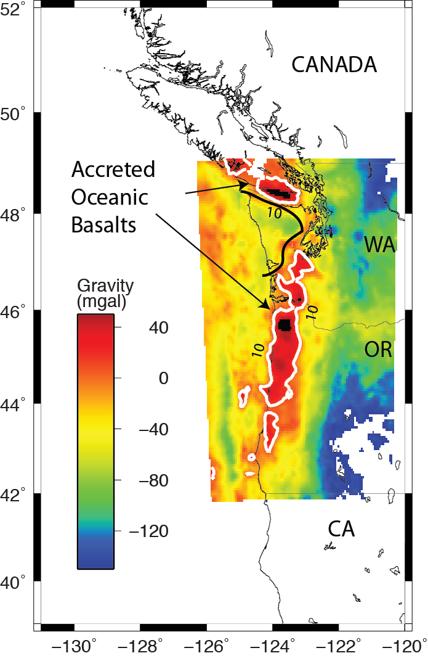
Siletz Terrane – Creepy?
Siletz terrane influences locking (Burgette et al., 2009)
Eocene age accreted basalt – Metchosin, Crescent and Siletz
Thickest near coastal central OR [Trehu et al. 1994]
Rigid – few earthquakes
Impermeable (?)
Dense – Large gravity anomalies
Bouguer (onshore) and free air (offshore)
gravity anomalies from Blakely et al., 2005

Slide 29
Siletz Terrane – Creepy?
Siletz terrane influences locking (Burgette et al., 2009)
Siletz East of Olympics
Siletz ~ 35km offshore
McCrory and Wilson, 2013

Slide 30
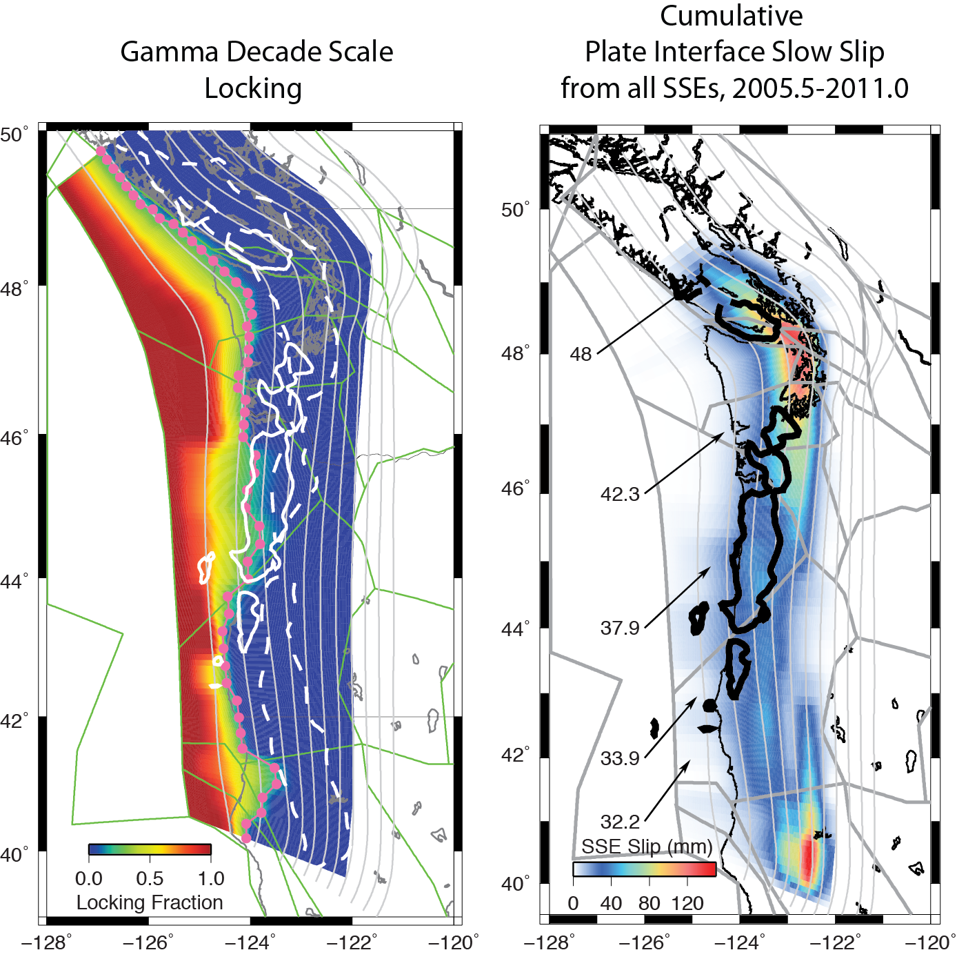
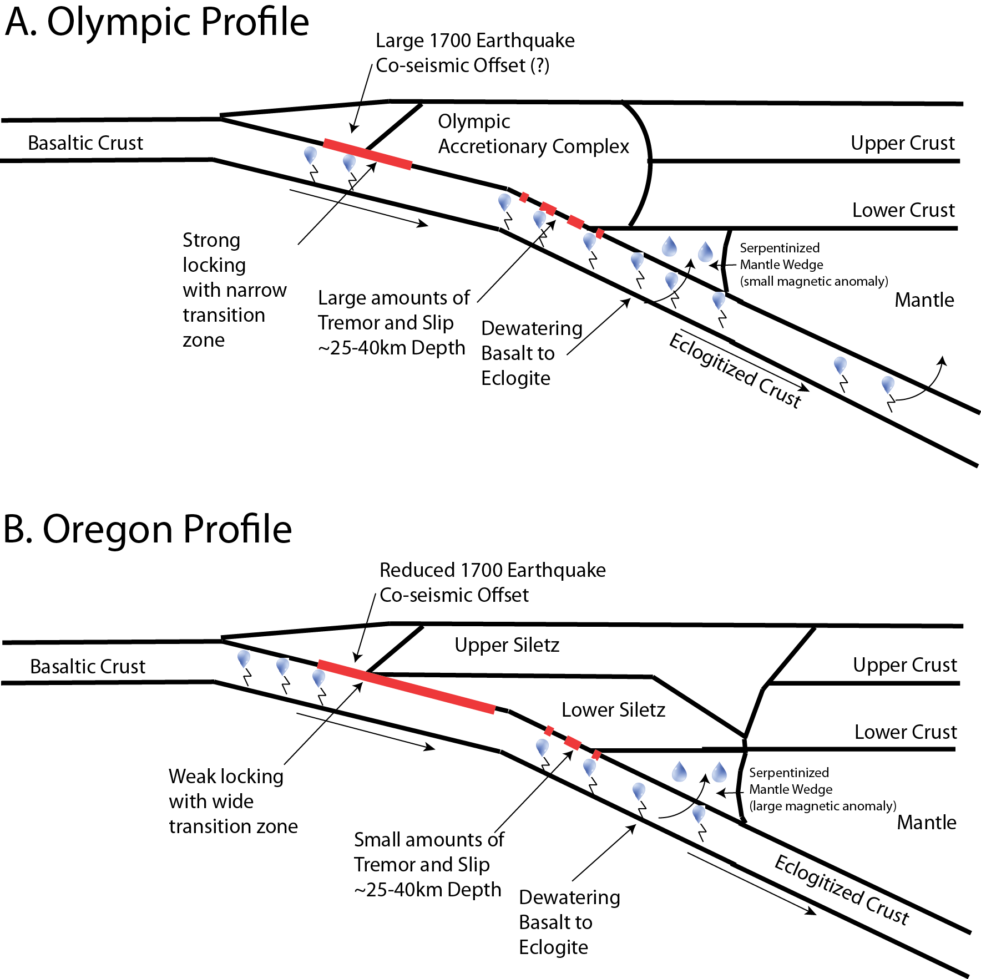
Summary of Observations

Slide 31
Summary of Observations

Slide 32
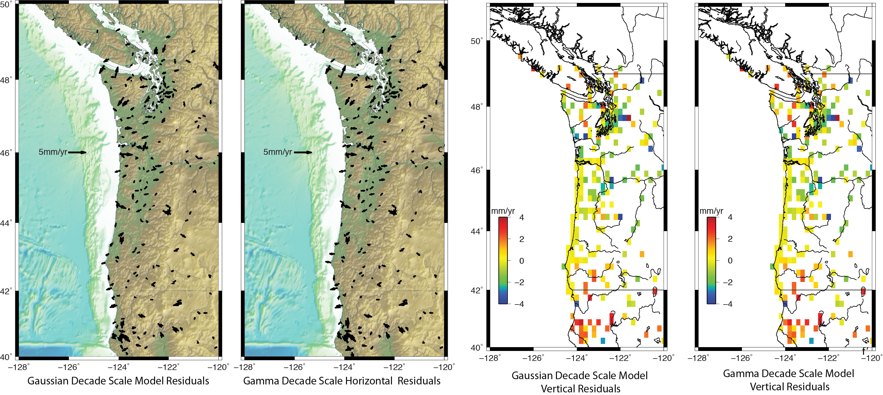
Model Residuals
Residuals nearly identical: reduced χ² = 1.6 for each
Same number of parameters

Slide 33
Model Horizontal Residuals

Slide 34
Model Vertical Residuals

Slide 35
Down-dip Similarities in Moment

Slide 36
Down-dip Similarities in Moment

Slide 37
Down-dip Similarities in Moment

Slide 38
Down-dip Similarities in Moment
Locking models are non-unique
Information in along strike locking variations near or on shore
Wide transition zone between ~44-46N aligns with Siletz

Slide 39
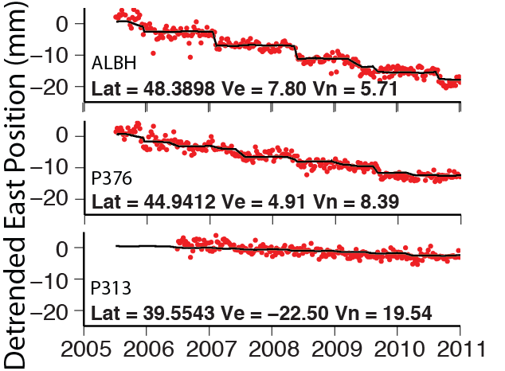
SSE Models Block Models
PANGA and PBO time series from 2005.5-2011
Inter-SSE Block rotations, homogeneous block strain rates for ECCR, WCCR and YFTB, and Gaussian locking are estimated
The time series estimates start time and seasonal signals are estimated as well as:
16 SSE events solved
Inter-SSE
Velocities
SSE
events
Start time,
Duration &
Amplitude
Estimated

Slide 40
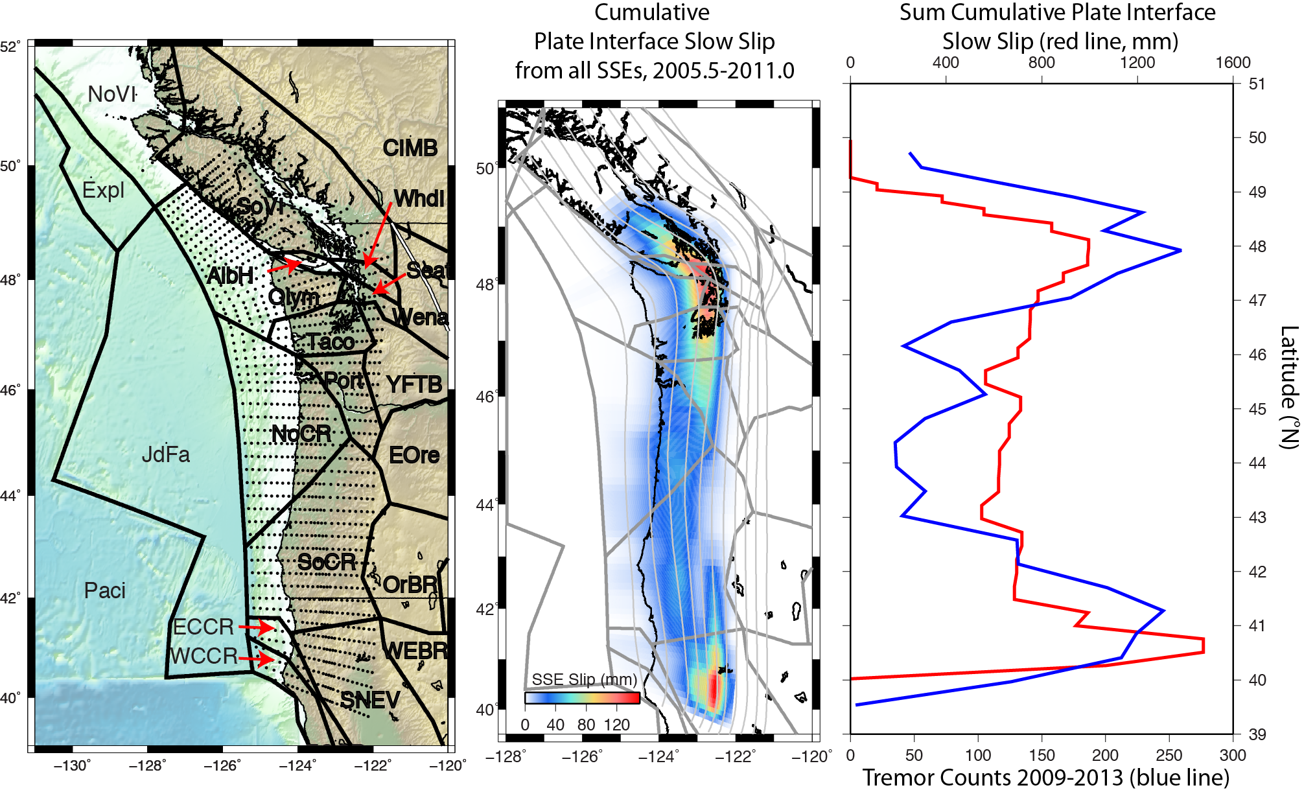
3. Cumulative Slow Slip 2005.5-2011

Slide 41
Creep and ETS
96% of tremors from 2009-2012 (white line)
Locking transition zone extends to the depth of slow slip in central Oregon -- however, models are non-unique

Slide 42
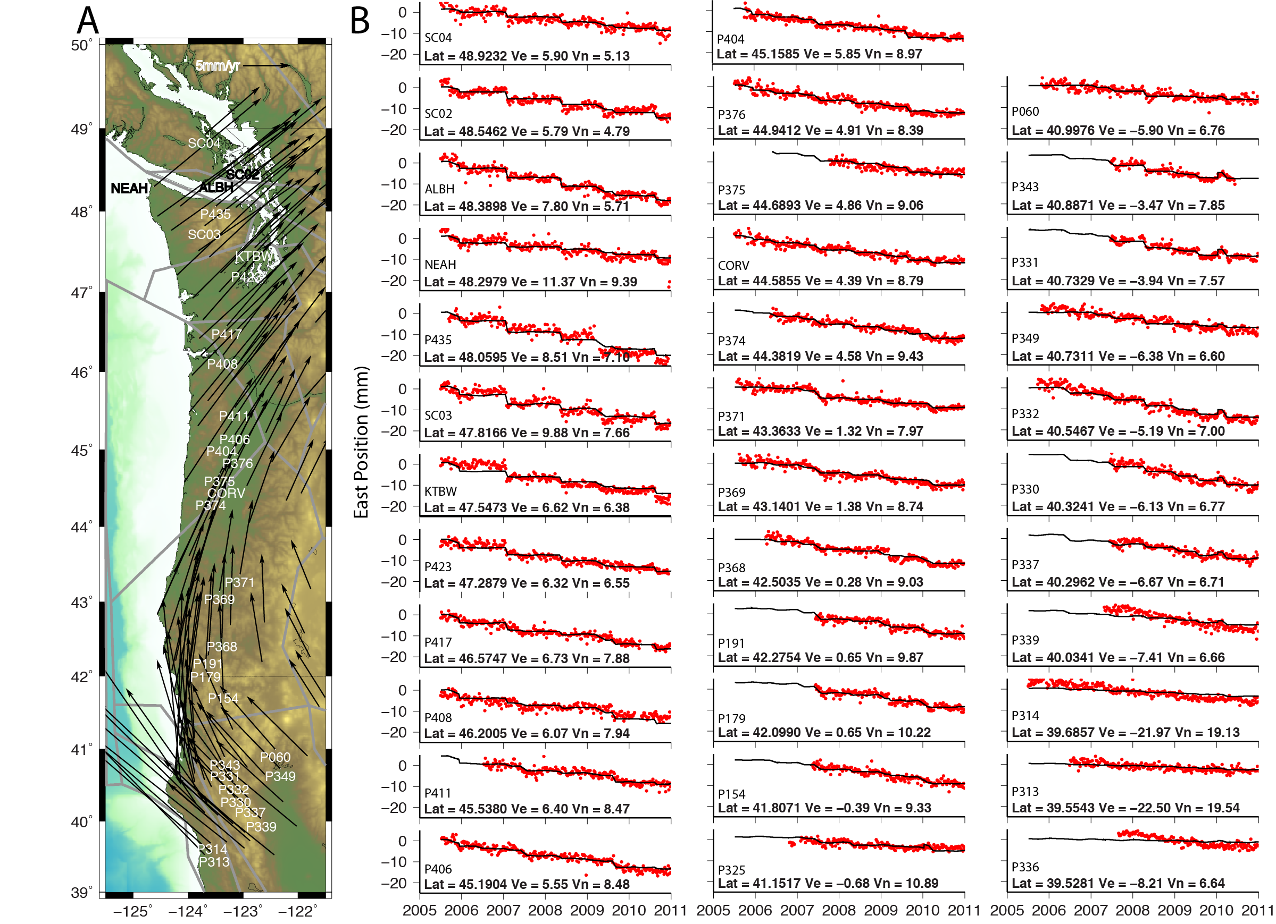
Fit to Time Series
Red χ² = 1.4

Slide 43
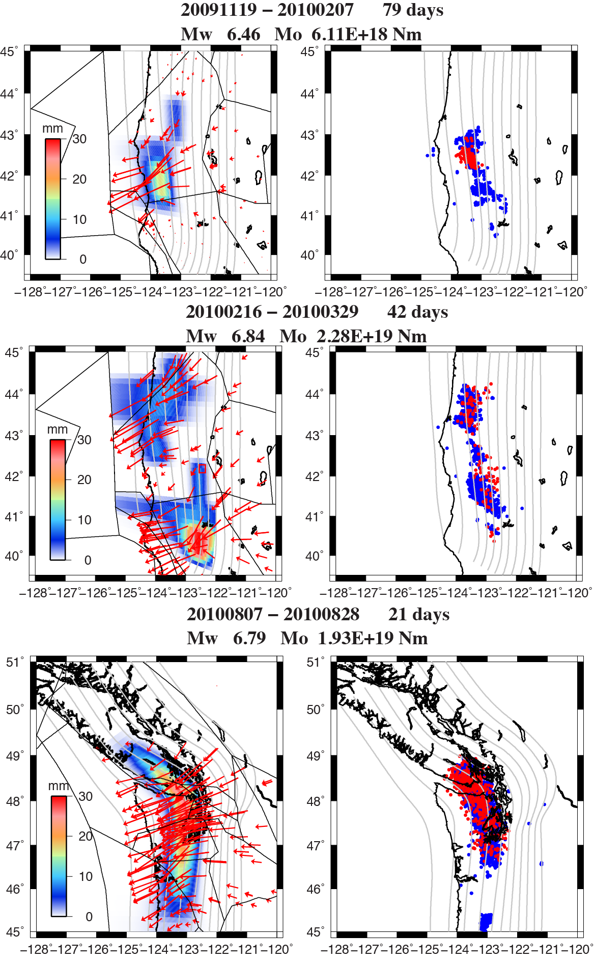
Example Events

Slide 44
3. Coseismic Subsidence from Paleoelevation Studies
Coseismic models of the 1700 earthquake
Heterogeneous rupture
In general, less slip between 43.5 and 46-47N
Ill-constrained between 47-49N and 41-43N
Wang et al., 2013
Notes:
Motion on the Pacific plate with respect to stable North America drives the Explorer, Juan de Fuca and Gorda plate to subduct beneath north America, creating the Cascadia Subduction Zone. Cascadia has a megathrust recurrence of about 3 to 600 years that are able to generate tsunamis. We know that the last megathrust earthquake occurred on January 26, 1700 because of Japanese records of a tsunami on that date. This earthquake ruptured about 1000km with ~20 m of slip, equating to a Magniture 8.7-9.2 event.

Slide 45
Siletz and Creep
Reyners and Eberhart-Phillips, 2009

Slide 46
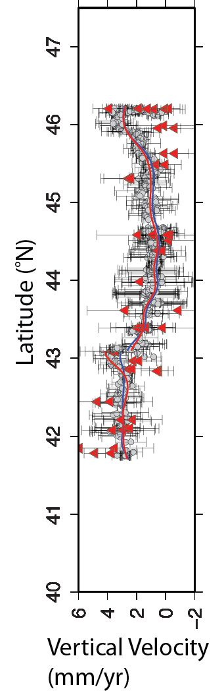
‘Decade Scale’ Velocities
GPS time series from PANGA and PBO
GPS velocities are the slope of 3 component position time series from 1997 – 2013 with earthquakes and equipment changes removed
Tide and Leveling uplift rates from Burgette et. al. [2009]
Reduced coastal interseismic uplift from ~43-46°N

Slide 47
Co-seismic
Inter-seismic
Vertical Velocity
(mm/a)

